Slide 1
Delivery Delay Prediction
A data-driven approach to estimating probability of delays

Slide 2

Introduction
Why delay prediction?
Customer satisfaction
Improved communication
Paves the way for dynamic delivery estimates
Risk Management and SLAs
Enhanced view of SLA compliance
Proactive mitigation strategies
Improved Partnering
Poor performance can be identified and addressed with couriers
Effective resource allocation
1 in 4 deliveries experiences a delay of 30 minutes or more

Slide 3
Introduction
Problem statement
DigiHaul collects data on every delivery including the delivery schedule, carrier, collection and delivery location, and vehicle type and would like to be able to estimate the probability of delay (i.e. delivery is completed > 30 mins after the latest scheduled delivery time) for new bookings.
Assumptions and Understanding
There is no pre-existing labelled dataset for delays, so one needed to be created from completed delivery data and their associated GPS tracks.
It is assumed that the delivery is completed at the GPS position that is closest to the delivery location.
Since we are interested in predicting the probabilities, not the classification of delayed vs on-time deliveries, we should use metrics that give best fit probabilities, not the best classification accuracy – 40% of shipments that have 40% probability of delay will be delayed, but they would all be classified as on-time by a classification model.

Slide 4
Method
Data Preparation
Merge GPS data with bookings data
Clean and transform data
Analyze patterns & relationships
Create training dataset
Model Selection & Training
Test multiple models
Select best models
Fine-tuning
Test
Model Evaluation
Performance metrics
Evaluation on un-labelled data

Slide 5
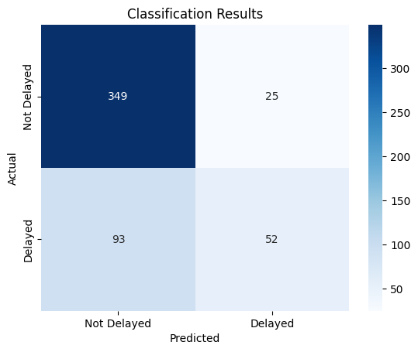
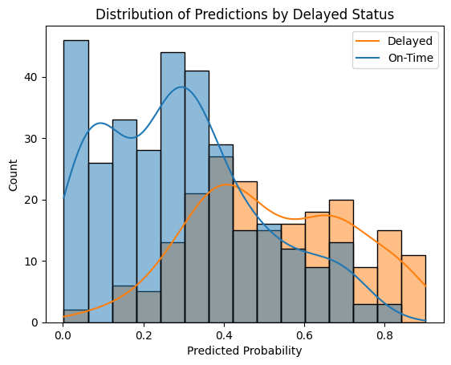
Results
The model achieved 71% accuracy on unseen data, but this can be misleading since there are more on-time deliveries than delays.
Only 36% of delays were correctly flagged.
85% of on-time deliveries were correctly identified.
However, accuracy isn’t the focus. A 30% delay probability means a 30% chance of delay, not that it won’t happen. What matters is that predicted probabilities align with actual outcomes.
From the chart, we see this holds true:
Low probabilities: Most deliveries were on time.
High probabilities: Most were delayed.
Mid-range: Around 50/50 split.
This shows the model's predictions align well with reality.

Slide 6
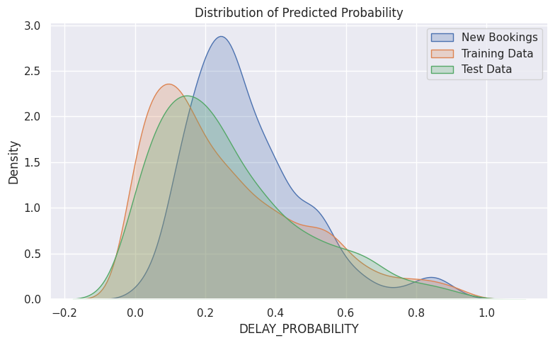
Results
To validate the model on new bookings (where delays are not yet known), we can compare the distribution of predicted probabilities. If upcoming bookings are similar to past ones, the distribution should be similar.
The distributions between training data and the test set are indeed similar, indicating model stability.
However, the New Bookings distribution shows a bias towards higher delay probabilities, as indicated by the red arrow.
Further investigation is needed. This shift could be due to more at-risk shipments or an intrinsic difference in the new bookings that may need to be incorporated into the model.

Slide 7
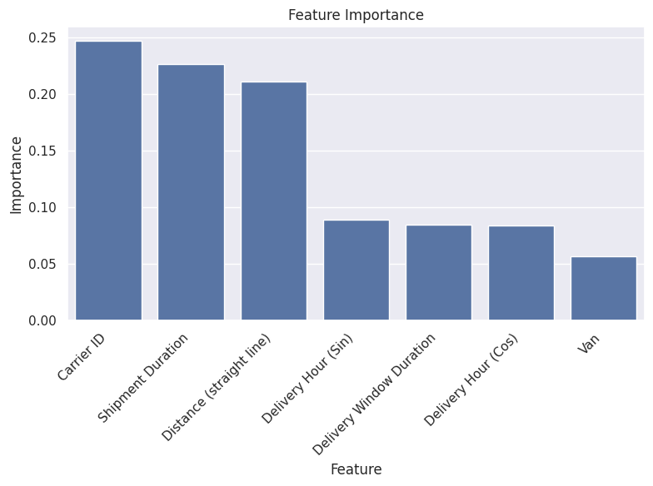
Results
Feature Importance
A measure of how useful the columns in the data are in predicting delays.
Carrier ID is most important, which suggests some carriers are under-performing. Deeper analysis is needed to understand which ones, then a strategic decision can be reached on how to address the issues.
Distance and Shipment Duration are also important, which is intuitive, but this distance is only a straight-line distance, not distance by road.

Slide 8
Next Steps
Model Refinement: Based on the findings, adjust the model to account for any differences in the new bookings and improve prediction accuracy.
Investigate Probability Shift: Analyze the cause of the higher delay probabilities in the new bookings. Determine if it's due to more at-risk shipments or other underlying factors.
Shipment Distances: Work has begun on including predicted journey times in the analysis using a routing API. Work will continue to improve the understanding of how to use this information in the model.
Carrier Performance: Undertake analysis to understand factors affecting carrier performance and identify poor performers to help the business make an informed decision on handling the issues.

